Slide 1
Congestion Control Mechanisms
for Data Center Networks
Wei Bai
Committee: Dr. Kai Chen (Supervisor),
Prof. Hai Yang (Chair), Prof. Qian Zhang, Dr. Wei Wang,
Prof. Jiang Xu, Prof. Fengyuan Ren
Notes:
Hello everyone. Welcome to my thesis defense. Today, I would like to talk about my thesis research, congestion control in data center networks.

Slide 2
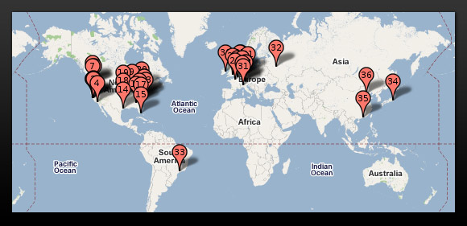

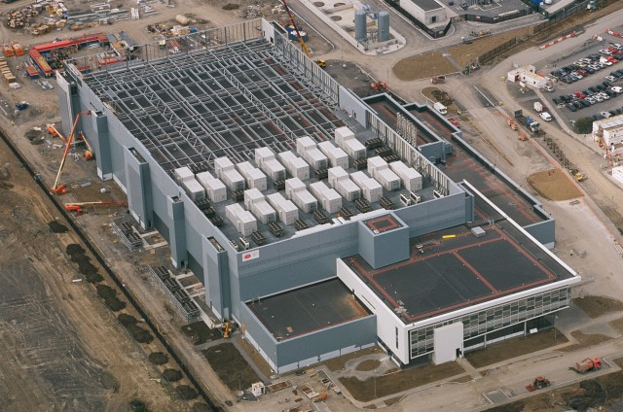
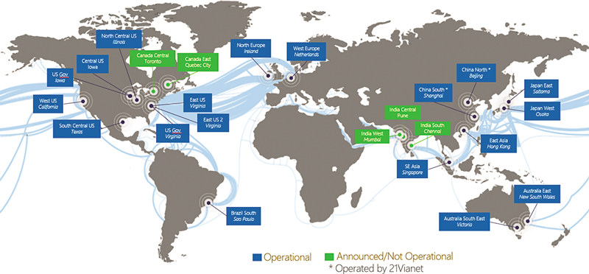
Data Centers Around the World
Google’s worldwide DC map
Facebook DC interior
Microsoft’s DC in Dublin, Ireland
Global Microsoft Azure DC Footprint
Notes:
As we know, many big companies, such as Google, Facebook and Microsoft, have built a lot of data centers around the world to provide services to global users.

Slide 3

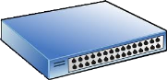

Data Center Network (DCN)
INTERNET
Fabric
Servers
Notes:
Inside the data center, the hundreds of thousands of servers are connected by this network, data center network, DCN.

Slide 4

Communication inside the Data Center
INTERNET
$≥$ 75% of traffic
Fabric
Servers
Notes:
Based on statistics, most global IP traffic originates or terminates in data centers. [click] In addition, more than 75% of data center communication stays within the data center.
Cisco forcasts: in 2011: ~300ExaBytes/year in IP WAN networks, ~1.5ZettaBytes/year in DC (forcasts show similar growth at 32% CAGR until 2015)

Slide 5
Communication inside the Data Center
This talk is about congestion control inside the data center.
INTERNET
$≥$ 75% of traffic
Fabric
Servers
Notes:
For this purpose, my PhD thesis focuses on congestion control mechanism for traffic staying within the data center.

Slide 6

TCP in the Data Center
$≥$99.9% of traffic is TCP traffic
Notes:
TCP is the dominant protocol in data centers to control the congestion. However, due to its Internet origin, TCP cannot satisfy all requirements of data center networks.

Slide 7
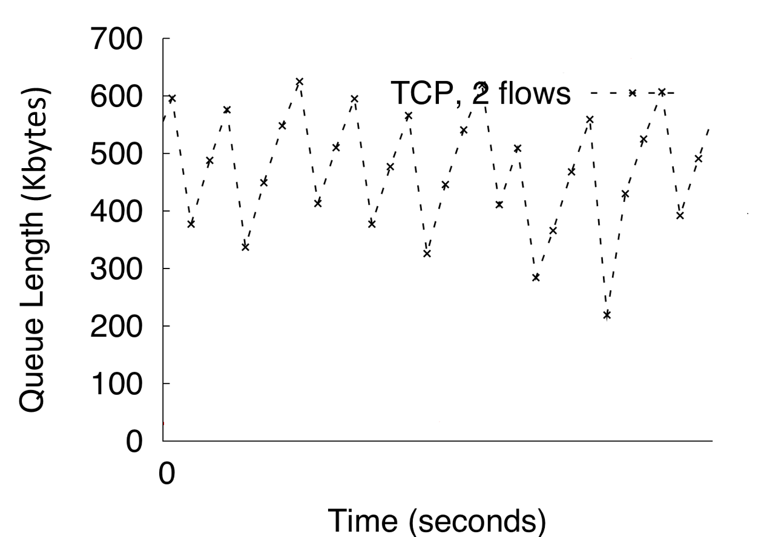
TCP in the Data Center
Queue length of the congested switch port
Maximum switch buffer size
Large queueing delay
M Alizadeh et al. (SIGCOMM’10)
Notes:
This figure shows the switch queue length achieved by two long-lived TCP flows to the same receiver.
The maximum switch buffer size is around 600KB. So we can see, TCP is very aggressive ….
[click] large queueing delay

Slide 8
Data center applications really care about latency!
Notes:
But unfortunately, applications in data centers really care about latency.

Slide 9



100ms slowdown reduced
# searches by 0.2-0.4%
[Speed matters for Google Web Search; Jake Brutlag]
Revenue decreased by 1% of sales for every 100ms latency
[Speed matters; Greg Linden]
400ms slowdown resulted
in a traffic decrease of 9%
[Yslow 2.0; Stoyan Stefanov]
Notes:
Google, Amazon and Yahoo report that the slowdown of latency seriously degrade user experience and operator revenue.

Slide 10
Goal of My Thesis
Low Latency Data Center Networks
Notes:
Therefore, the goal of my thesis is to achieve low latency in data center networks.

Slide 11
Thesis Components
Packet In
Buffer Management
Accept the packet if there is enough buffer space
Active Queue Management
Mark the packet to reduce switch queueing
Packet
Scheduler
Decide the sequence of packets to transmit
Packet Out
Notes:
In the network, congestion happens at the switch. This figure shows a typical pipeline of the switching chip. 解释three components My thesis centers around these three components.

Slide 12
Thesis Components
Packet In
Buffer Management
Active Queue Management
Packet
Scheduler
PIAS: minimize flow completion time without prior knowledge
Packet Out
Notes:
First, I propose PIAS. PIAS leverages the strict priority queueing at the switch to minimize FCT without prior knowledge

Slide 13
Thesis Components
Packet In
Buffer Management
MQ-ECN (& TCN): enable ECN marking over packet schedulers
Active Queue Management
Packet
Scheduler
PIAS: minimize flow completion time without prior knowledge
Packet Out
Notes:
Second, I identify the undesirable interactions between AQM and packet schedulers on existing commodity switching chips. Then I propose MQ-ECN and TCN, two ECN/AQM solutions to ……

Slide 14
Thesis Components
Packet In
BCC: a simple solution for high speed extremely shallow-buffered DCNs
Buffer Management
MQ-ECN (& TCN): enable ECN marking over packet schedulers
Active Queue Management
Packet
Scheduler
PIAS: minimize flow completion time without prior knowledge
Packet Out
Notes:
Third, I propose BCC, a …. BCC only requires one more AQM configuration at the switch.

Slide 15
Outline
Packet In
Buffer Management
PIAS: minimize flow completion time without prior knowledge
Active Queue Management
NSDI’15, ToN’17
Packet
Scheduler
Packet Out
Notes:
Now, we start from PIAS. This work appears in USENIX NSDI 2015 and ToN 2017.

Slide 16




Flow Completion Time (FCT) is Key
Data center applications
Desire low latency for short messages
App performance & user experience
Goal of DCN transport: minimize FCT
Many flow scheduling proposals
Notes:
Many data center applications, such as Web search, machine learning, database and cache, desire ultra low latency for these short messages. The reason is that the completion times of these short messages directly determine the user experience. Therefore, to improve the application performance, one of the most important design goal for data center transport is to minimize flow completion times, especially for short flows. To address this challenge, there are many flow scheduling proposals, [click]

Slide 17
Existing Solutions
PDQ
SIGCOMM’12
pFabric
SIGCOMM’13
PASE
SIGCOMM’14
All assume prior knowledge of flow size information to approximate ideal preemptive Shortest Job First (SJF) with customized network elements
Not feasible for many applications
Hard to deploy in practice
Notes:
Such as PDQ, pFabric and PASE. These solutions can potentially provide very good, even near-optimal performance. However, we find that, [click] all of them assume prior knowledge of flow size information to approximate ideal preemptive shortest job first scheduling. In addition to this, all of these solutions leverage customized network elements. For example, pFabric introduces non-trivial modifications to switch hardware and PASE requires an separate and complex control plane for arbitration. [click] We note that, the assumption of prior knowledge of flow size information does not hold for many cases. For many applications, such as database query and response, data is transferred as soon as it is generated without buffering. So we can not get flow size information beforehand. [click] And the customized network elements make these solutions very hard to deploy in production data centers. So we take one step back [click]

Slide 18
Question
Without prior knowledge of flow size information, how to minimize FCT in commodity data centers?
Notes:
And ask a fundamental question ……………….. This question transfers to three concrete design goals.

Slide 19
Design Goal 1
Without prior knowledge of flow size information, how to minimize FCT in commodity data centers?
Information-agnostic: not assume a priori knowledge of flow size information available from the applications

Slide 20
Design Goal 2
Without prior knowledge of flow size information, how to minimize FCT in commodity data centers?
FCT minimization: minimize the average and tail FCTs of short flows & not adversely affect FCTs of large flows

Slide 21
Design Goal 3
Without prior knowledge of flow size information, how to minimize FCT in commodity data centers?
Readily-deployable: work with existing commodity switches & be compatible with legacy network stacks

Slide 22
Our Answer
Without prior knowledge of flow size information, how to minimize FCT in commodity data centers?
PIAS: Practical Information-Agnostic flow Scheduling

Slide 23
PIAS Key Idea
PIAS performs Multi-Level Feedback Queue (MLFQ) to emulate Shortest Job First (SJF)
High
Priority 1
Priority 2
……
Low
Priority K
Notes:
The design rationale of PIAS is performing multi-level feedback queue to emulate shortest job first. As we can see, there are K priority queues in MLFQ. 1 is the highest priority while K is the lowest one. During a flow’s life time, its priority is gradually reduced. [click]

Slide 24
PIAS Key Idea
PIAS performs Multi-Level Feedback Queue (MLFQ) to emulate Shortest Job First (SJF)
Priority 1
Priority 2
……
Priority K
Notes:
For example, for this flow. The first packet is assigned to the priority 1. [click]. The second packet is demoted to priority 2. [click] For the third packet, its priority is further reduced. [click]. Eventually, if this flow is large enough, the last packet is assigned to the lowest priority. You can see that, the key idea of multi-level feedback queue is very simple and it does not require flow size information to do the scheduling.

Slide 25
PIAS Key Idea
PIAS performs Multi-Level Feedback Queue (MLFQ) to emulate Shortest Job First (SJF)
In general, PIAS short flows finish in higher priority queues while large ones in lower priority queues, emulating SJF, effective for heavy tailed DCN traffic.
Notes:
With MLFQ, small flows are more likely to finish in higher priority queues while large flows are more likely to finish in lower priority queues. Therefore, small flows are prioritized over large flows, thus emulating SJF, especially for heavy tailed DCN workloads.

Slide 26
How to implement PIAS?
Implementing MLFQ at switch directly not scalable
Requires switch to keep per-flow state
Priority 1
Priority 2
……
Priority K
Notes:
However, MLFQ is not supported on commodity switches because it’s hard to track per-flow state on switches.

Slide 27
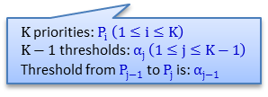
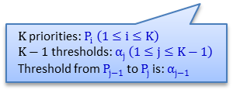
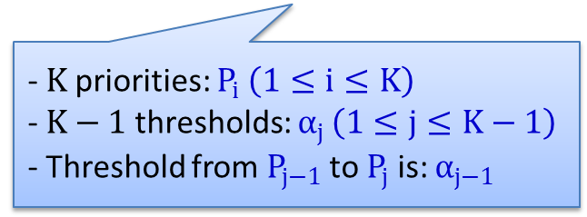
How to implement PIAS?
Decoupling MLFQ
Stateless Priority Queueing at the switch (a built-in function)
Stateful Packet Tagging at end hosts (a shim layer between TCP/IP and NIC)
Priority 1
- $K$priorities: $P_{i} \left(1≤i≤K\right)$
$\text{−} K−1$ thresholds: $α_{j }\left(1≤j≤K−1\right)$
- Threshold from $P_{j−1}$ to $P_{j}$ is: $α_{j−1 }$
Priority 2
……
Priority K
$K$priorities: $P_{i} \left(1≤i≤K\right)$
$K−1$ thresholds: $α_{j }\left(1≤j≤K−1\right)$
Threshold from $P_{j−1}$ to $P_{j}$ is: $α_{j−1 }$
$K$priorities: $P_{i} \left(1≤i≤K\right)$
$K−1$ thresholds: $α_{j }\left(1≤j≤K−1\right)$
Threshold from $P_{j−1}$ to $P_{j}$ is: $α_{j−1 }$
Notes:
To solve this problem, we decouple multi-level feedback queue. On the switch, we enable strict priority queueing [click]. At end hosts, we have a packet tagging module[click]. The logic of packet tagging module is quite simple. Assuming that they are K priorities and K-1 demotion thresholds correspondingly. Note that the P1 is the highest priority. The packet tagging module just maintains per-flow state and compare the bytes sent information with demotion thresholds. If a flow’s bytes sent value is exactly larger than Alpha[j-1], the following packet of this flow will be marked with Pj. For example, [click]

Slide 28
How to implement PIAS?
Decoupling MLFQ
Stateless Priority Queueing at the switch (a built-in function)
Stateful Packet Tagging at end hosts (a shim layer between TCP/IP and NIC)
i
Priority 1
- $K$priorities: $P_{i} \left(1≤i≤K\right)$
$\text{−} K−1$ thresholds: $α_{j }\left(1≤j≤K−1\right)$
- Threshold from $P_{j−1}$ to $P_{j}$ is: $α_{j−1 }$
Priority 2
……
Priority K
$K$priorities: $P_{i} \left(1≤i≤K\right)$
$K−1$ thresholds: $α_{j }\left(1≤j≤K−1\right)$
Threshold from $P_{j−1}$ to $P_{j}$ is: $α_{j−1 }$
$K$priorities: $P_{i} \left(1≤i≤K\right)$
$K−1$ thresholds: $α_{j }\left(1≤j≤K−1\right)$
Threshold from $P_{j−1}$ to $P_{j}$ is: $α_{j−1 }$
Notes:
解释例子

Slide 29
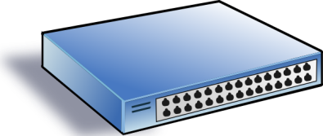
Threshold vs Traffic Mismatch
DCN traffic is highly dynamic
Threshold fails to catch traffic variation → mismatch
10MB
Ideal, threshold = 20KB
10MB
High
Low
Too small, 10KB
ECN
20KB
Too big, 1MB
Notes:
To determine demotion thresholds for MLFQ, we build a simple queueing theory model to analyze it and derive demotion thresholds based on flow size distributions. However, traffic is highly dynamic in data centers (across both time and space), so the mismatch between traffic and demotion thresholds is unavoidable. We need to handle the mismatch problem in order keep PIAS effective in highly dynamic data center networks? [click] 解释例子

Slide 30
PIAS in 1 Slide
PIAS packet tagging
Maintain flow states and mark packets with priority
PIAS switch
Enable strict priority queueing and ECN
PIAS rate control
Employ Data Center TCP to react to ECN
Notes:
Now, we summarize the design of PIAS in 1 slide. PIAS has 3 components. The first one is packet tagging module at end hosts. It tracks per-flow state and mark packets with priority. At the switch, PIAS only enables strict priority queueing and ECN. Both of these two are basic functionalities of most commodity switches. To react to ECN, PIAS leverage DCTCP as transport layer protocol. All of these three components are very easy to implement and configure in production data centers.

Slide 31

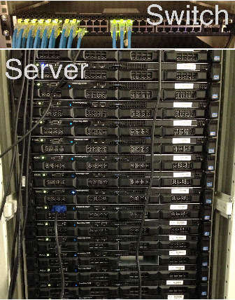
Prototyping & Evaluation
Prototype implementation
http://sing.cse.ust.hk/projects/PIAS
Testbed experiments and ns-2 simulations
1G in testbed experiments
10G/40G in simulations
Realistic production traffic
Schemes compared
DCTCP (both testbed and simulation)
pFabric (only simulation)
Notes:
Now, we come to evaluation part. We have already implemented a PIAS prototype. [click] It is open source. In our implementation, the packet tagging module works as a Linux kernel module, which can be installed and removed during the running time of the system. We use 16 servers and 1 Gigabit switch for our evaluation. For the benchmarks, we use web search workload from DCTCP paper, data mining workload from VL2 paper.

Slide 32
Testbed: Small Flows (<100KB)
49%
34%
Web Search
Data Mining
PIAS reduces average FCT of small flows by up to 49% and 34%, compared to DCTCP.
Notes:
These two figures show the average completion times of small flows. Compared to DCTCP, PIAS reduces average FCT of small flows by up to 49% in web search workload and 34% in data mining workload. Even though DCTCP try to reduce buffer occupation to achieve low latency, it still needs moderate buffer occupation to fully utilize link capacity. But with PIAS, we can provide much fewer or even zero queueing delay for packets of short flows because they are finished in higher priority queues.

Slide 33
NS-2: Comparison with pFabric
Web Search
Data Mining
PIAS only has a 1% performance gap to pFabric for small flows in the data mining workload.
Notes:
We also compare PIAS against pFabric. Note that pFabric is a information-aware clean-slate design. It assumes prior knowledge of flow size information and introduces changes to switch hardware. For PIAS, we don’t make such assumptions and just use commodity switches. Compared to pFabric, PIAS achieves comparable performance in small flows, especially in data mining workload. [click] The performance gap here here is only 1%.

Slide 34
PIAS Recap
PIAS: practical and effective
Not assume flow information from applications
Enforce Multi-Level Feedback Queue scheduling
Use commodity switches & legacy network stacks
Information-agnostic
FCT minimization
Readily deployable
Notes:
Finally, we conclude our work. We think that PIAS is a practical and effective solution for data centers. First of all, it is information-agnostic without assuming that flow size information available from applications. Secondly, PIAS performs multi-level feedback queue to emulate shortest job fist, thus achieving FCT minimization. Thirdly, PIAS is readily deployable in commodity data centers. It just uses basic functionalities from commodity switches and is compatible with legacy network stacks.

Slide 35
Outline
Packet In
Buffer Management
MQ-ECN (& TCN): enable ECN marking over packet schedulers
Active Queue Management
Packet
Scheduler
NSDI’16, CoNEXT’16
Packet Out
Notes:
Now, let’s move to second piece of work, MQ-ECN and TCN. MQ-ECN is accepted by NSDI 2016. TCN is accepted by CoNEXT 2016. Due to the time limitation,

Slide 36



Background
Data Centers
Many services with diverse network requirements
Notes:
Today’s data centers host many services and applications with diverse network requirements. Some services desire high throughput. Some services desire low latency. Some services desire both high throughput and low latency.

Slide 37
Background
Data Centers
Many services with diverse network requirements
ECN-based Transports
ECN = Explicit Congestion Notification
Notes:
To satisfy such diverse network requirements, many people have leveraged ECN, explicit congestion notification, to design new transport mechanisms for data center networks.

Slide 38

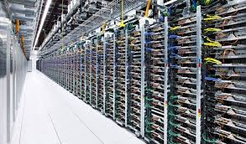
Background
Data Centers
Many services with diverse network requirements
ECN-based Transports
Achieve high throughput & low latency
Widely deployed: DCTCP, DCQCN, etc.
Notes:
With ECN, we can achieve high throughput even with little buffer occupancy. Due to their simplicity and effectiveness, many ECN-based transports, such as DCTCP and DCQCN, are being deployed in production data centers.

Slide 39
ECN-based Transports
Notes:
ECN-based transports actually consist of two parts.

Slide 40
ECN-based Transports
ECN-enabled end-hosts
React to ECN by adjusting sending rates
Notes:
The first part is ECN-enabled end-hosts. End-hosts reduce their sending rates when they see ECN marks.

Slide 41
ECN-based Transports
ECN-enabled end-hosts
React to ECN by adjusting sending rates
ECN-aware switches
Perform ECN marking based on Active Queue Management (AQM) policies
Notes:
The other part is ECN-aware switches. Switches need to perform ECN marking based on AQM policies to deliver congestion information.

Slide 42
ECN-based Transports
ECN-enabled end-hosts
React to ECN by adjusting sending rates
ECN-aware switches
Perform ECN marking based on Active Queue Management (AQM) policies
Our focus
Notes:
In this work, we focus on the ECN marking scheme at the switch.

Slide 43
ECN-aware Switches
Adopt RED to perform ECN marking
RED = Random Early Detection
Notes:
Today’s commodity switches typically adopt RED, random early detection, to perform ECN marking.

Slide 44
ECN-aware Switches
Adopt RED to perform ECN marking
Per-queue/port/service-pool ECN/RED
Track buffer occupancy of different egress entities
Notes:
More specially, there are several ECN/RED implementation on the switch, such as per-queue, per-port and per-service-pool ECN/RED. The key difference among these schemes is that they track buffer occupancy of different egress entities to make ECN marking decisions.

Slide 45
ECN-aware Switches
Adopt RED to perform ECN marking
Per-queue/port/service-pool ECN/RED
queue 1
port
queue 2
Notes:
In per-queue ECN marking, we track the buffer occupancy of each queue to make ECN marking decisions. Each queue has its own ECN marking threshold and performs ECN marking independently to other queues. An arrival packet gets ECN marked if the per-queue buffer occupancy is larger than per-queue ECN marking threshold.

Slide 46
ECN-aware Switches
Adopt RED to perform ECN marking
Per-queue/port/service-pool ECN/RED
queue 1
port
queue 2
Notes:
In per-port ECN marking, we track the total buffer occupancy of a switch port to make ECN marking decisions. Each port has its own ECN marking threshold. An arrival packet gets ECN marked if the per-port buffer occupancy is larger than the per-port ECN marking threshold.

Slide 47
ECN-aware Switches
Adopt RED to perform ECN marking
Per-queue/port/service-pool ECN/RED
shared buffer
queue 1
port
queue 2
queue 3
port
queue 4
Notes:
In per-service-pool ECN marking, we track the total buffer occupancy of a shared buffer pool to make ECN marking decisions.

Slide 48
ECN-aware Switches
Adopt RED to perform ECN marking
Per-queue/port/service-pool ECN/RED
Leverage multiple queues to classify traffic
Isolate traffic from different services/applications
Notes:
As we have shown, commodity switches have provided multiple queues for each egress port. Current operation practice is to leverage multiple queues to isolate traffic from different services/applications.

Slide 49
ECN-aware Switches
Adopt RED to perform ECN marking
Per-queue/port/service-pool ECN/RED
Leverage multiple queues to classify traffic
Isolate traffic from different services/applications
Services running DCTCP
Services running TCP
Services running UDP
Notes:
For example, we can isolate traffic from different services based on their protocols.

Slide 50
ECN-aware Switches
Adopt RED to perform ECN marking
Per-queue/port/service-pool ECN/RED
Leverage multiple queues to classify traffic
Isolate traffic from different services/applications
Real-time services
Best-effort services
Background services
Notes:
We can also isolate services based on their importance.

Slide 51
ECN-aware Switches
Adopt RED to perform ECN marking
Per-queue/port/service-pool ECN/RED
Leverage multiple queues to classify traffic
Isolate traffic from different services/applications
Weighted max-min fair sharing among queues
Real-time services
Weight = 4
Best-effort services
Weight = 2
Background services
Weight = 1
Notes:
Among the queues, operators typically enforce weighted max-min fair sharing policy since they don’t want to persistently starve a whole service for long time. For example, we can assign a high weight to more important real-time services and a low weight to less important background services.

Slide 52
ECN-aware Switches
Adopt RED to perform ECN marking
Per-queue/port/service-pool ECN/RED
Leverage multiple queues to classify traffic
Isolate traffic from different services/applications
Weighted max-min fair sharing among queues
Perform ECN marking in multi-queue context
Notes:
In summary, in production data centers with multiple services, we need to perform ECN marking in multi-queue context. This is the problem we want to explore.

Slide 53
ECN marking with Single Queue
Notes:
To understand this problem, we start from the simplest scenario, ECN marking with single queue.

Slide 54
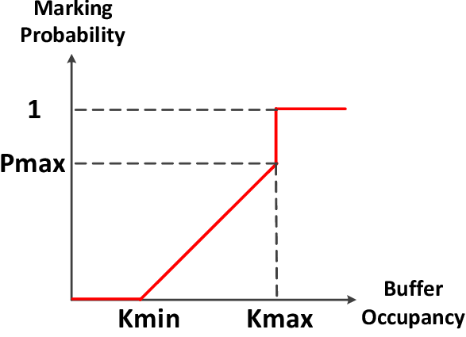
ECN marking with Single Queue
RED Algorithm
Notes:
This figure shows that how RED calculates marking probability based on buffer occupancy. It has at least three parameters: Kmin, Kmax and Pamx.

Slide 55
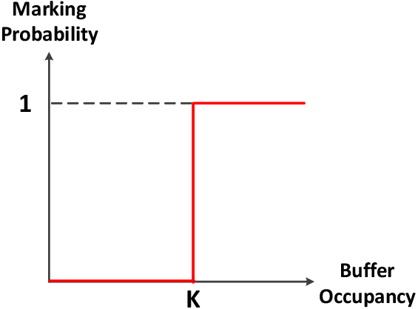
ECN marking with Single Queue
RED Algorithm
Practical Configuration
(e.g., DCTCP)
Notes:
In practice, operators typically set Kmin and Kmax to the same value. In this way, there is only one ECN marking threshold, K, that we need to configure. A packet gets marked if the buffer occupancy is larger than K.

Slide 56

ECN marking with Single Queue
To achieve 100% throughput
$$K≥C×RTT×λ$$
Notes:
To achieve 100% throughput for TCP flows, K should be no smaller than C times RTT times lambda.

Slide 57
ECN marking with Single Queue
To achieve 100% throughput
$$K≥C×RTT×λ$$
Determined by congestion control algorithms
Notes:
C times RTT is bandwidth delay product. Lambda is a fixed parameter determined by congestion control algorithms at end hosts. For example, lambda is 1 for regular ECN-enabled TCP which simply cuts window by half in the presence of ECN.

Slide 58
ECN marking with Single Queue
To achieve 100% throughput
$$K≥C×RTT×λ$$
Standard ECN marking threshold
Notes:
Here, we call C times RTT times lambda as the standard ECN marking threshold since it is the value we can use to fully utilize link capacity while delivering low latency.

Slide 59

ECN marking with Single Queue
To achieve 100% throughput
$$K≥C×RTT×λ$$
Static value in DCNs,
e.g., 65 packets for 10G network (DCTCP paper)
Notes:
In homogeneous data center networks, RTT is relatively stable. And C is given, lambda is given. So it is feasible for us to compute a static value as the standard ECN marking threshold. For example, in DCTCP paper, the authors recommend using 65 packets as the marking threshold for 10G network.

Slide 60
ECN marking with Multi-Queue (1)
Notes:
Now, we move to ECN marking in multi-queue context.

Slide 61
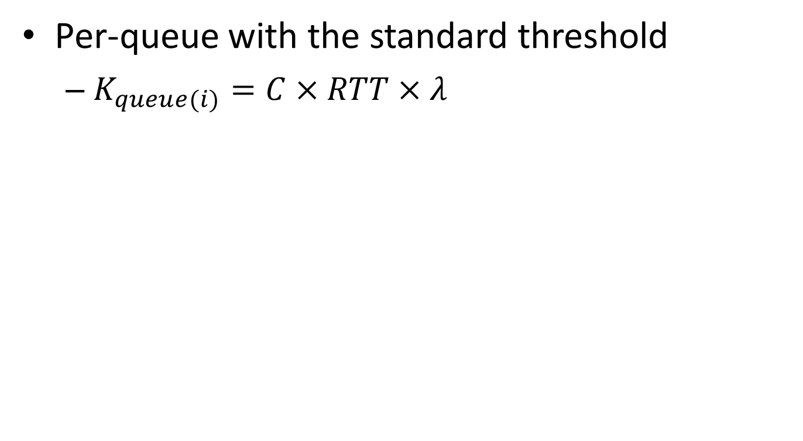
ECN marking with Multi-Queue (1)
Per-queue with the standard threshold
$K_{queue(i)}=C×RTT×λ$
standard threshold
Mark
Don’t mark
queue 1
queue 2
port
queue 3
Notes:
In multi-queue context, per-queue ECN making is widely employed by operators due to its good isolation among different queues. To fully utilize the link capacity in any condition, many operators configure the standard ECN marking threshold for each queue. In this way, any queue can independently fully utilize the link capacity regardless of traffic dynamics. To the best of our knowledge, this is current operation practice in industry.

Slide 62
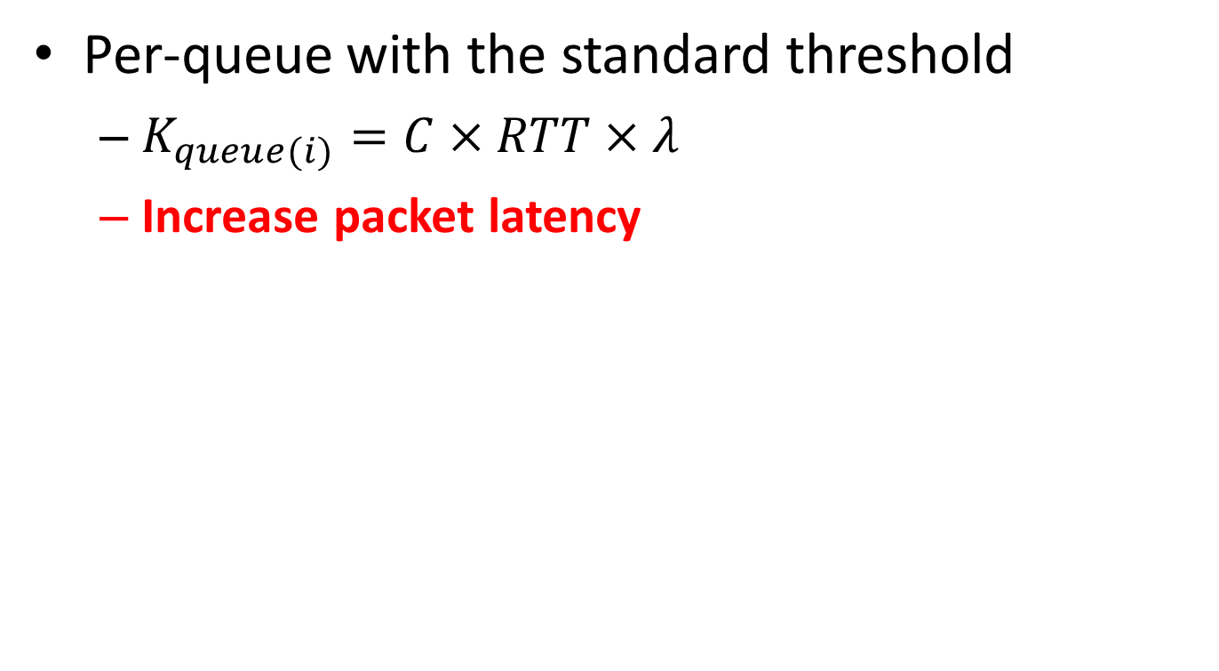
ECN marking with Multi-Queue (1)
Per-queue with the standard threshold
$K_{queue(i)}=C×RTT×λ$
Increase packet latency
standard threshold
Mark
Don’t mark
queue 1
queue 2
port
queue 3
Notes:
However, such configuration will increase packet latency when many queues are concurrently active.

Slide 63
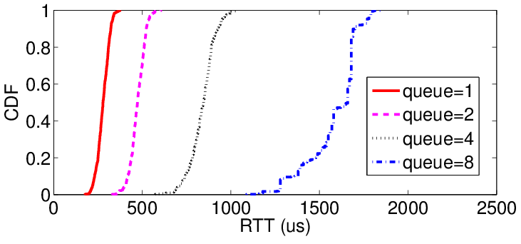
ECN marking with Multi-Queue (1)
Per-queue with the standard threshold
$K_{queue(i)}=C×RTT×λ$
Increase packet latency
Evenly classify 8 long-lived flows into a varying number of queues
Notes:
To confirm this, we even classify 8 long-lived flows into a varying number of queues. As we can see from this figure, more queues lead to worse latency.

Slide 64
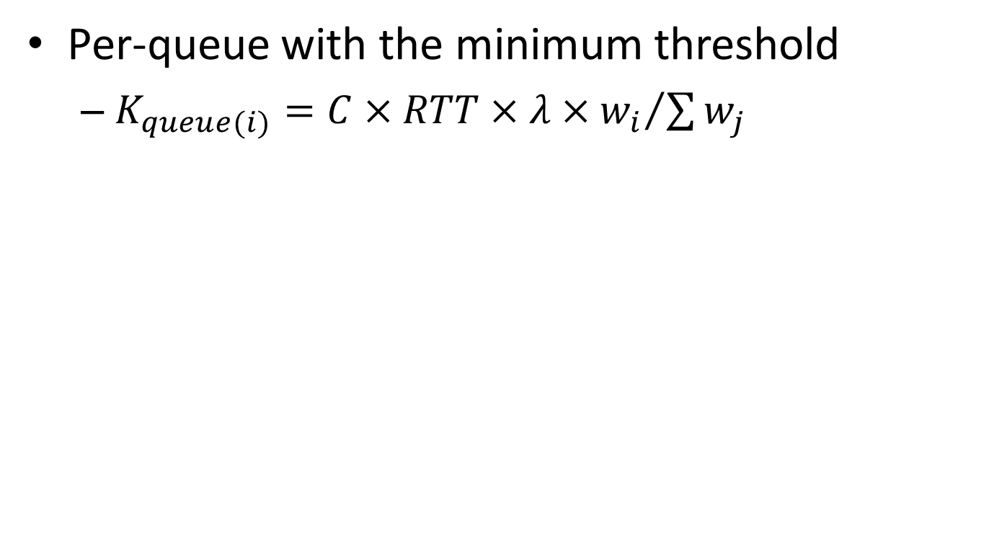
ECN marking with Multi-Queue (2)
Per-queue with the minimum threshold
$K_{queue(i)}=C×RTT×λ×{w_{i}}/{\sum{w_{j}}}$
Normalized weight
minimum threshold
Mark
Don’t mark
queue 1
queue 2
port
queue 3
Notes:
Realizing above limitation, an alternative approach is to divide the standard ECN marking threshold into different queues based on queue weights. In this formula, Wi is the weight of queue i. So Wi over the sum of Wj is the normalized weight of queue i. Such configuration can achieve good latency even when all the queues are concurrently active.

Slide 65
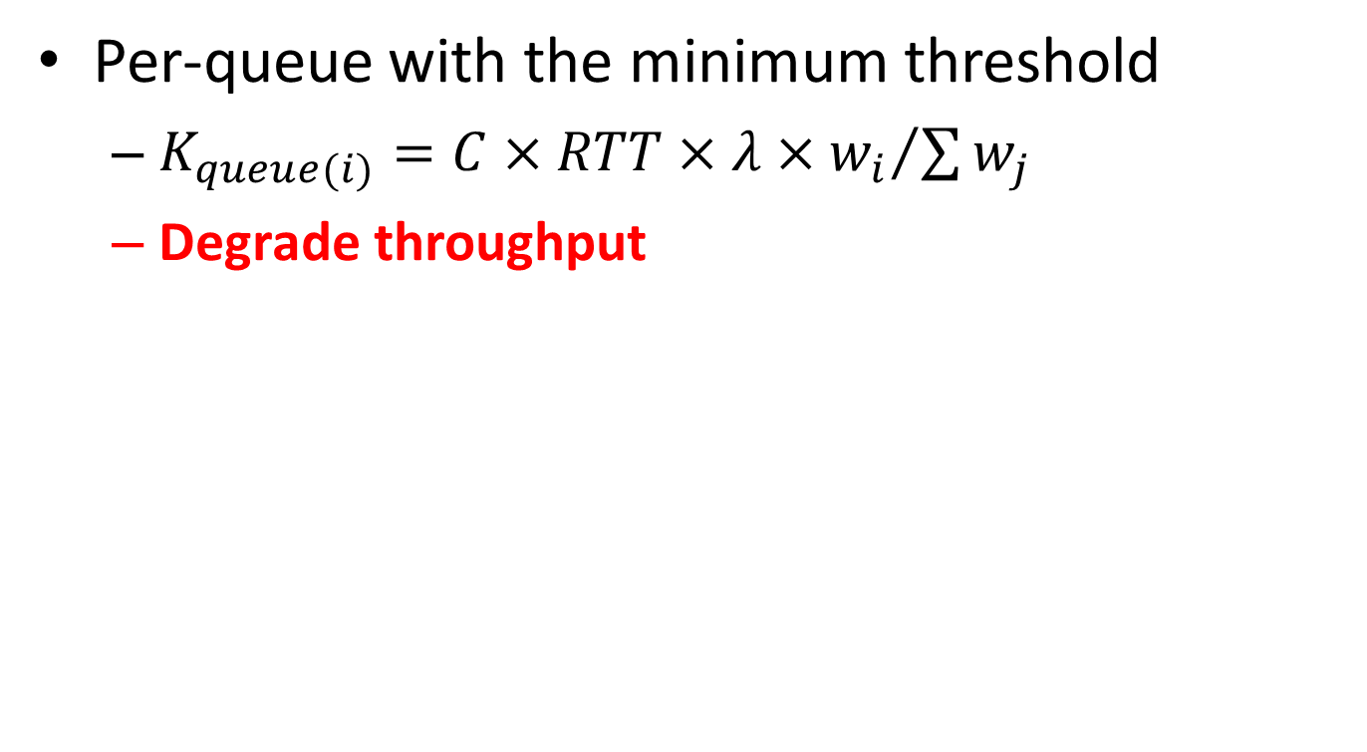
ECN marking with Multi-Queue (2)
Per-queue with the minimum threshold
$K_{queue(i)}=C×RTT×λ×{w_{i}}/{\sum{w_{j}}}$
Degrade throughput
minimum threshold
Mark
Don’t mark
queue 1
queue 2
port
queue 3
Notes:
However, it will degrade throughput when very few queues are active simultaneously.

Slide 66
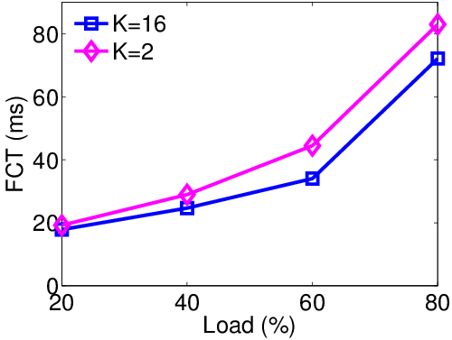
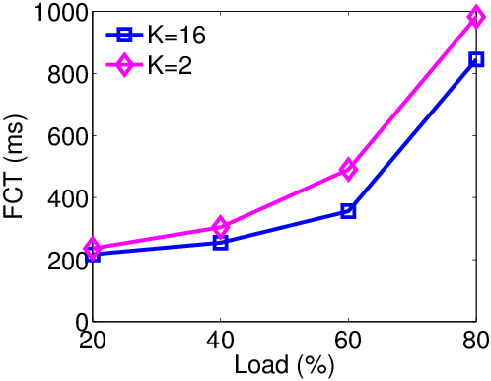
ECN marking with Multi-Queue (2)
Per-queue with the minimum threshold
$K_{queue(i)}=C×RTT×λ×{w_{i}}/{\sum{w_{j}}}$
Degrade throughput
Overall Average FCT
Average FCT (>10MB)
Notes:
To confirm this, we consider an extreme case where only one queue is active. As we can see from these figures, the threshold of 16 packets can achieve better performance compared to the threshold of 2 packets.

Slide 67
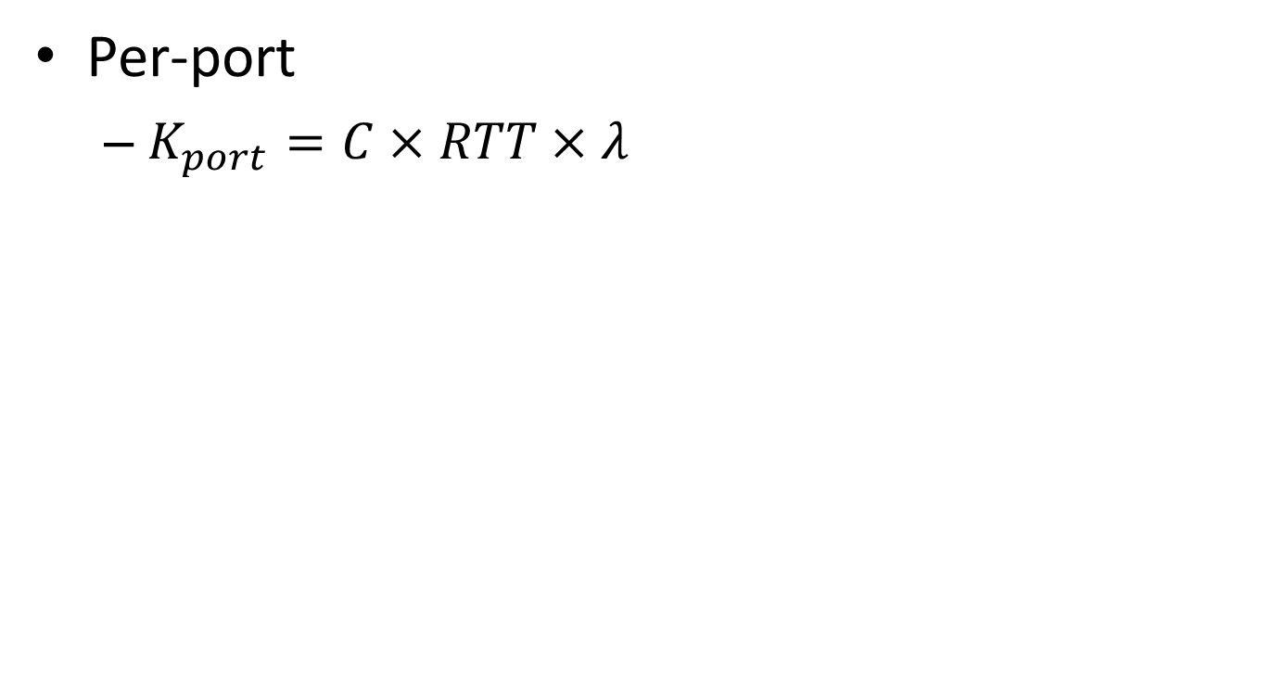
ECN marking with Multi-Queue (3)
Per-port
$K_{port}=C×RTT×λ$
standard threshold
Mark
Don’t mark
queue 1
queue 2
port
queue 3
Notes:
Unlike previous two per-queue-based approaches, we can use per-port ECN/RED to achieve both high throughput and low latency by setting the per-port marking threshold to the standard ECN marking threshold.

Slide 68
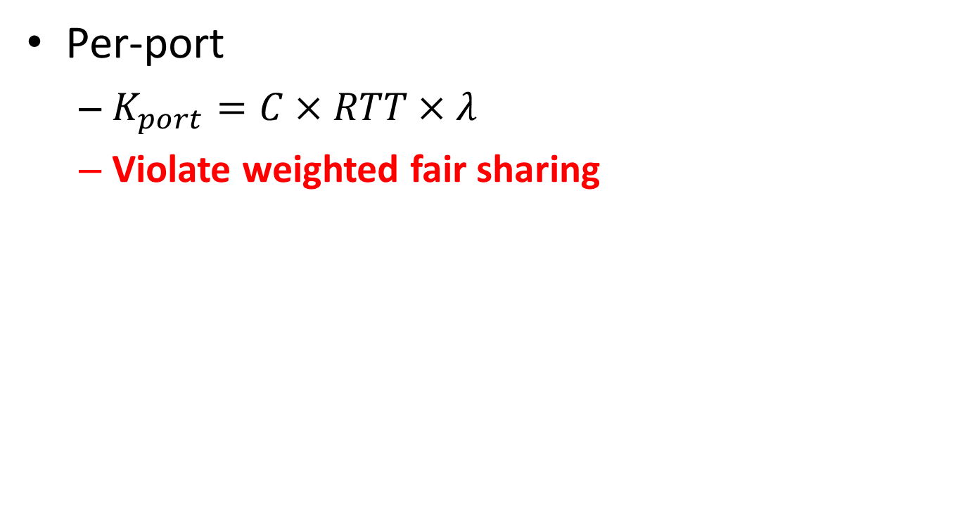
ECN marking with Multi-Queue (3)
Per-port
$K_{port}=C×RTT×λ$
Violate weighted fair sharing
standard threshold
Mark
Don’t mark
queue 1
queue 2
port
queue 3
Notes:
However, per-port ECN/RED cannot ensure isolation among different queues. Packets from one queue can get ECN marked due to the buffer occupancy of other queues. As a result, per-port ECN/RED can seriously violate the weighted fair sharing policy among queues. We believe this problem will be more serious if we use per-service-pool ECN/RED as queues from different ports can interfere with each other.

Slide 69
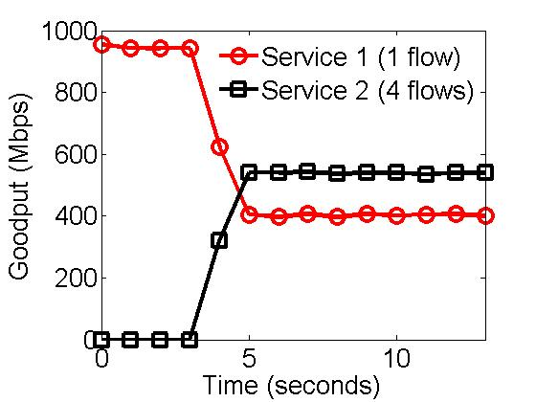
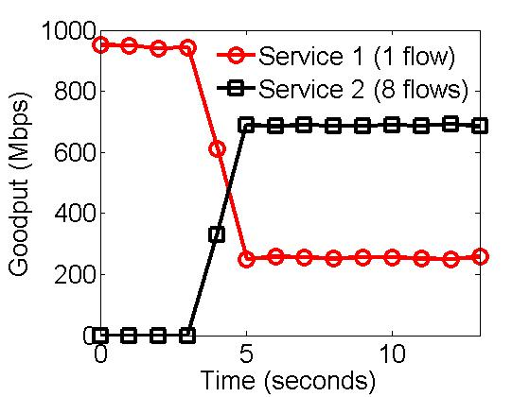
ECN marking with Multi-Queue (3)
Per-port
$K_{port}=C×RTT×λ$
Violate weighted fair sharing
Both services have a equal-weight dedicated queue on the switch
Notes:
To confirm this impairment, we classify traffic into two services. Both services have a equal-weight dedicated queue on the switch. According to scheduling policy, both services should always fairly share the link capacity. However, as we can see, with per-port ECN/RED, service 2 can get more bandwidth when we increase its number of flows.

Slide 70
Question
Can we design an ECN marking scheme with following properties:
Deliver low latency
Achieve high throughput
Preserve weighted fair sharing
Compatible with legacy ECN/RED implementation
Notes:
Here, we take one step back and ask a question, can we design an ECN marking scheme that achieve low latency and high throughput while strictly preserving weighted fair sharing policy? In addition, for hardware implementation friendliness, we also require the scheme should perform RED like enqueue ECN marking. More specially, our solution should compare buffer occupancy against a threshold at the enqueue side to make marking decisions.

Slide 71
Question
Can we design an ECN marking scheme with following properties:
Deliver low latency
Achieve high throughput
Preserve weighted fair sharing
Compatible with legacy ECN/RED implementation
Our answer: MQ-ECN
Notes:
Our answer is MQ-ECN

Slide 72
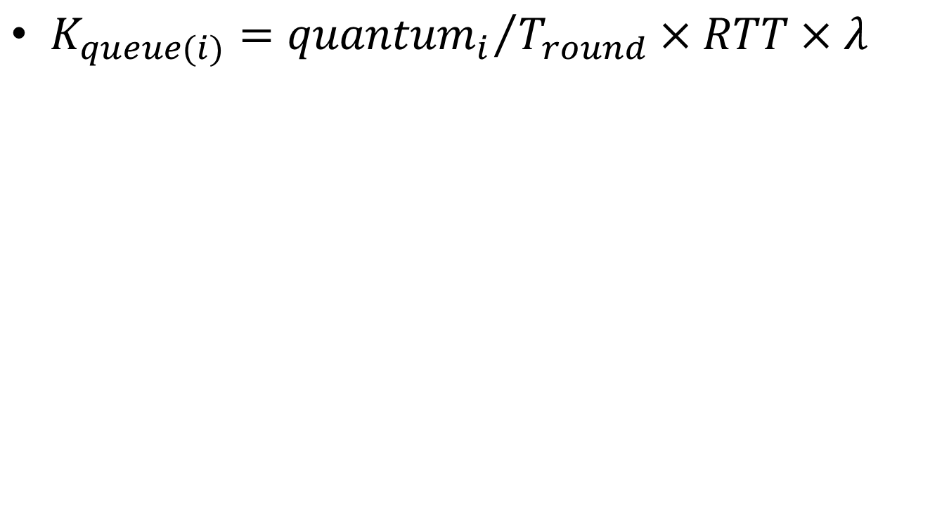
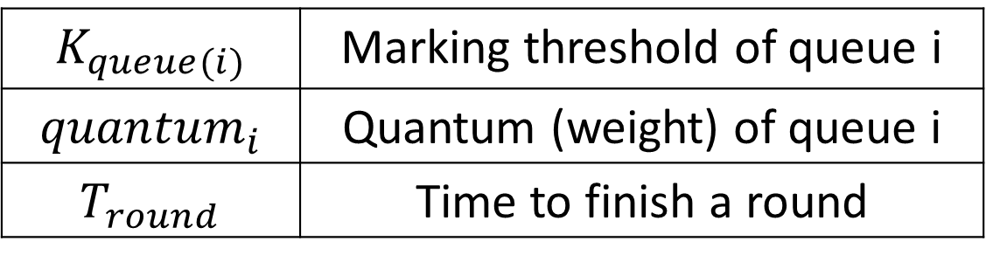
MQ-ECN
$K_{queue(i)}={{quantum}_{i}}/{T_{round}}×RTT×λ$
$$K_{queue(i)}$$ | Marking threshold of queue i
$${quantum}_{i}$$ | Quantum (weight) of queue i
$$T_{round}$$ | Time to finish a round
For round robin schedulers in production DCNs
Notes:
This formula shows how MQ-ECN calculates the per-queue queue length threshold. Note that MQ-ECN is designed for round robin schedulers which are widely used in today’s production data centers. 解释formula含义

Slide 73
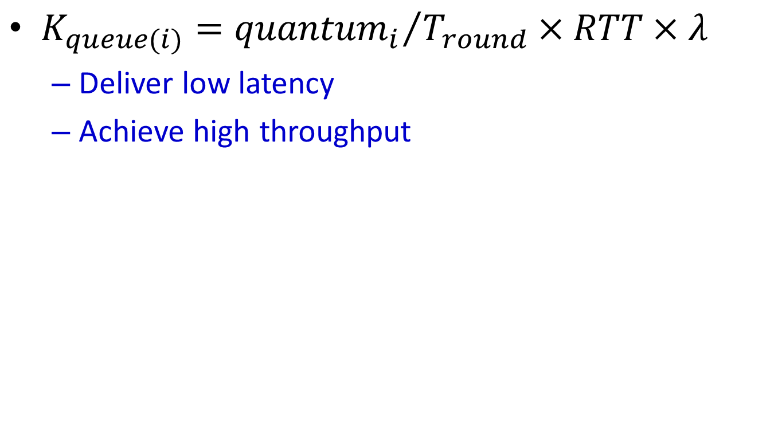

MQ-ECN
$K_{queue(i)}={{quantum}_{i}}/{T_{round}}×RTT×λ$
Deliver low latency
Achieve high throughput
$K_{queue(i)}$ adapts to traffic dynamics
Notes:
First of all, we find that, T round reflects traffic dynamics. When many queues are active, T round becomes very large. MQ-ECN reduces per-queue marking thresholds to achieve low latency. When few queues are active, T round is small. MQ-ECN increases per-queue thresholds to achieve high throughput.

Slide 74
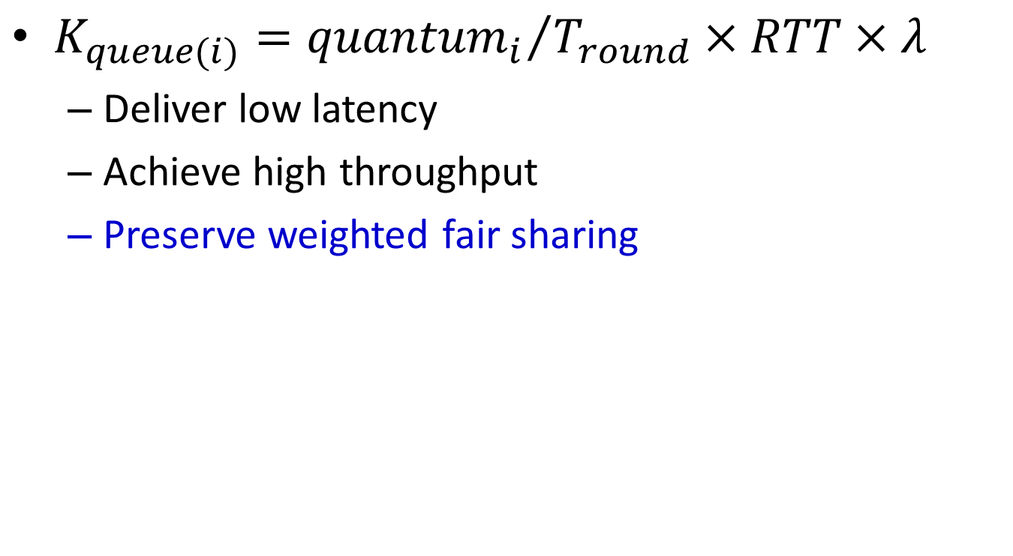

MQ-ECN
$K_{queue(i)}={{quantum}_{i}}/{T_{round}}×RTT×λ$
Deliver low latency
Achieve high throughput
Preserve weighted fair sharing
$K_{queue(i)}$is in proportion to the weight
Notes:
Second, quantum i ensures that marking thresholds of different queues are in proportional to their weights. Therefore, MQ-ECN can strictly preserve weighted fair sharing policy.

Slide 75
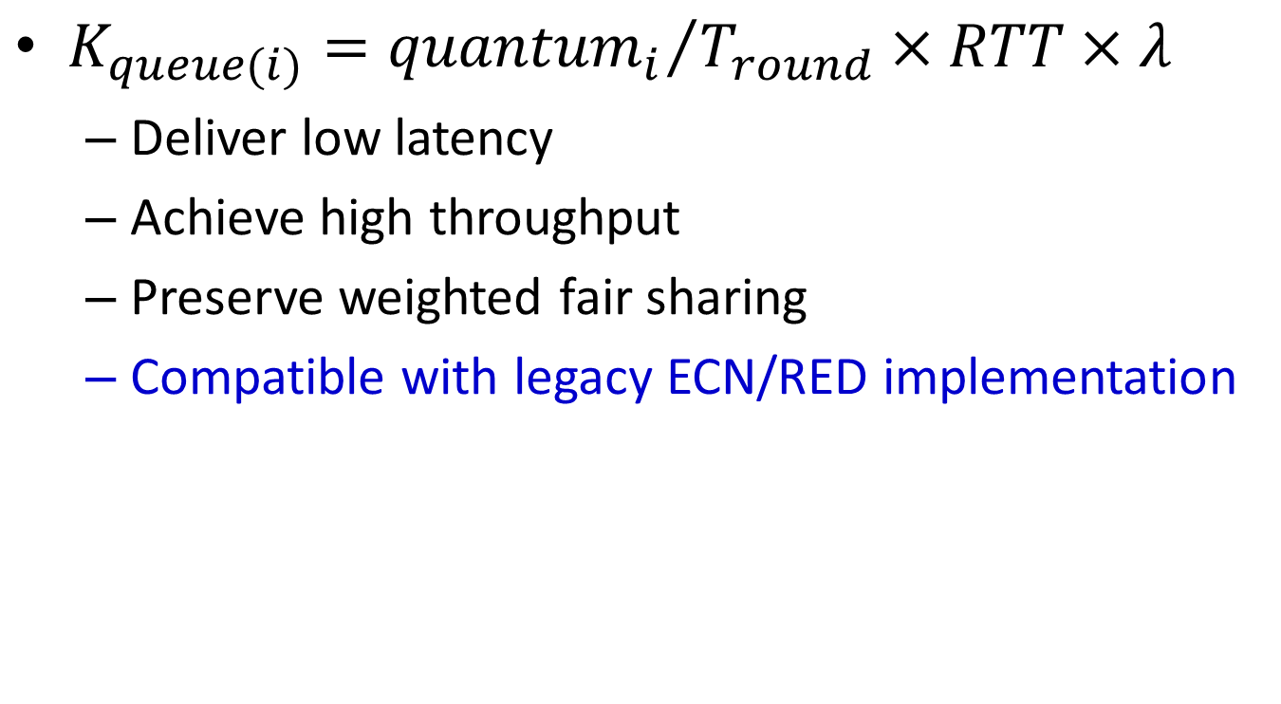
MQ-ECN
$K_{queue(i)}={{quantum}_{i}}/{T_{round}}×RTT×λ$
Deliver low latency
Achieve high throughput
Preserve weighted fair sharing
Compatible with legacy ECN/RED implementation
Per-queue ECN/RED with dynamic thresholds
Notes:
Third, in this formula, quantum i, RTT and lambda are all given. T round is varying according to traffic dynamics. So, MQ-ECN is essentially a per-queue ECN/RED scheme with dynamic thresholds.

Slide 76
Testbed Evaluation
MQ-ECN software prototype
Linux qdisc kernel module performing DWRR
Testbed setup
9 servers are connected to a server-emulated switch with 9 NICs
End-hosts use DCTCP as the transport protocol
Benchmark traffic
Web search workload
More results in large-scale simulations
Notes:
We have implemented a MQ-ECN software prototype as a Linux qdisc kernel module. We build a testbed with 9 servers connected to a server-emulated software switch. At end-host, we use DCTCP as the transport protocol. We generate realistic traffic according to the web search workload in DCTCP paper. We also conduct large-scale simulations to complement our testbed experiments. Here, we just show testbed experiment results.

Slide 77
Static Flow Experiment
1 flow
Service 1
weight
1
1
Service 2
4 flows
Notes:
We start from a simple static flow experiment. In this experiment, service 1 has 1 flow while service 2 has 4 flows. Both services have a equal-weight queue on the switch.

Slide 78
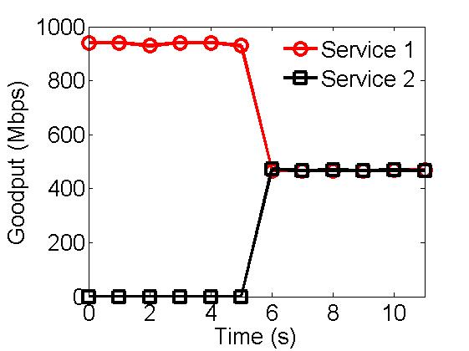
Static Flow Experiment
Notes:
This figure gives aggregate goodputs of two services achieved by MQ-ECN. In contrast to results achieved by per-port ECN/RED, both services fairly share the link capacity regardless of the number of flows.

Slide 79
Static Flow Experiment
MQ-ECN preserves weighted fair sharing
Notes:
This indicates that MQ-ECN can strictly preserve weighted fair sharing policy.

Slide 80
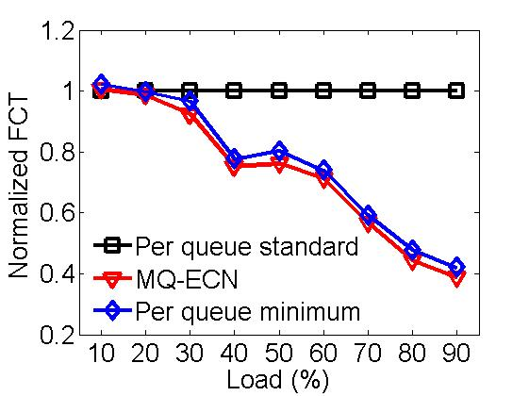
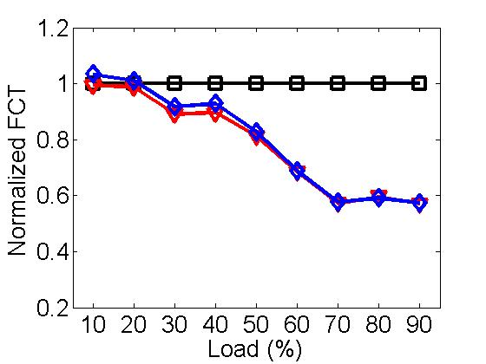
Realistic Traffic: Small Flows (<100KB)
Balanced traffic pattern
Unbalanced traffic pattern
Notes:
These figures show FCT results of small flows in realistic traffic workload. MQ-ECN achieves comparable performance as the minimum threshold while greatly outperforming the standard threshold. Compared to per-queue ECN/RED with the standard threshold, MQ-ECN can achieve up to 60% and 40% lower average FCT for small flows, respectively.

Slide 81
Realistic Traffic: Small Flows (<100KB)
Balanced traffic pattern
Unbalanced traffic pattern
MQ-ECN achieves low latency
Notes:
This indicates that MQ-ECN can achieve low latency.

Slide 82
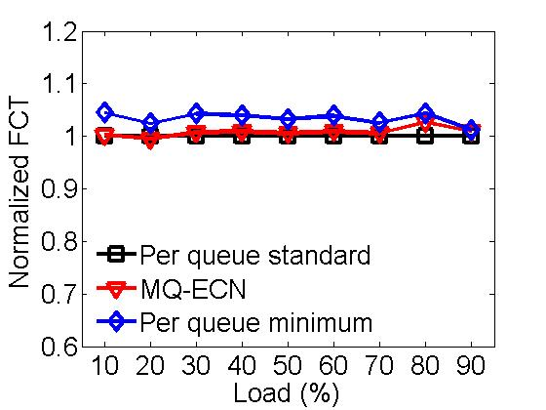
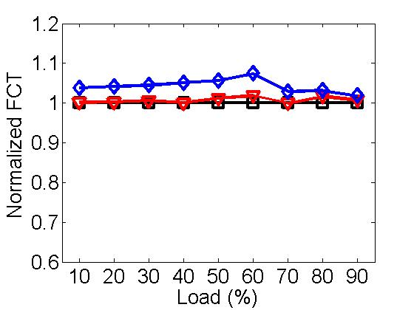
Realistic Traffic: Large Flows (>10MB)
Balanced traffic pattern
Unbalanced traffic pattern
Notes:
These figures gives the results of large flows. As we can see, MQ-ECN performs very similar as the standard threshold while obviously outperforming the minimum threshold.

Slide 83
Realistic Traffic: Large Flows (>10MB)
Balanced traffic pattern
Unbalanced traffic pattern
MQ-ECN achieves high throughput
Notes:
This indicates that MQ-ECN can achieve high throughput.

Slide 84
MQ-ECN Recap
Identify performance impairments of existing ECN/RED schemes in multi-queue context
MQ-ECN: for round robin schedulers (current practice) in production DCNs
Dynamically adjust the queue length threshold
High throughput, low latency, weighted fair sharing
Code & Data:
http://sing.cse.ust.hk/projects/MQ-ECN
Notes:
In this work, we identify performance impairments of existing ECN/RED schemes in multi-queue context. Then we propose MQ-ECN, a simple yet effective ECN/RED scheme for round-robin packet schedulers. MQ-ECN can achieve high throughput and low latency while preserving weighted fair sharing policy.

Slide 85
Follow-Up: TCN
Goal
Enable ECN for arbitrary packet schedulers
Key Ideas
Use sojourn time as the congestion signal
Perform instantaneous ECN marking

Slide 86
Outline
Packet In
Buffer Management
BCC: a simple solution for high speed extremely shallow-buffered DCNs
Active Queue Management
In submission to SOSP’17
Packet
Scheduler
Packet Out
Notes:
Third,

Slide 87
Switch Buffer
Switch buffer is crucial for TCP’s performance
High throughput
Low packet loss rate
Occupancy
Size
K
Time
Notes:
This work is about switch buffer. buffer对TCP很重要

Slide 88
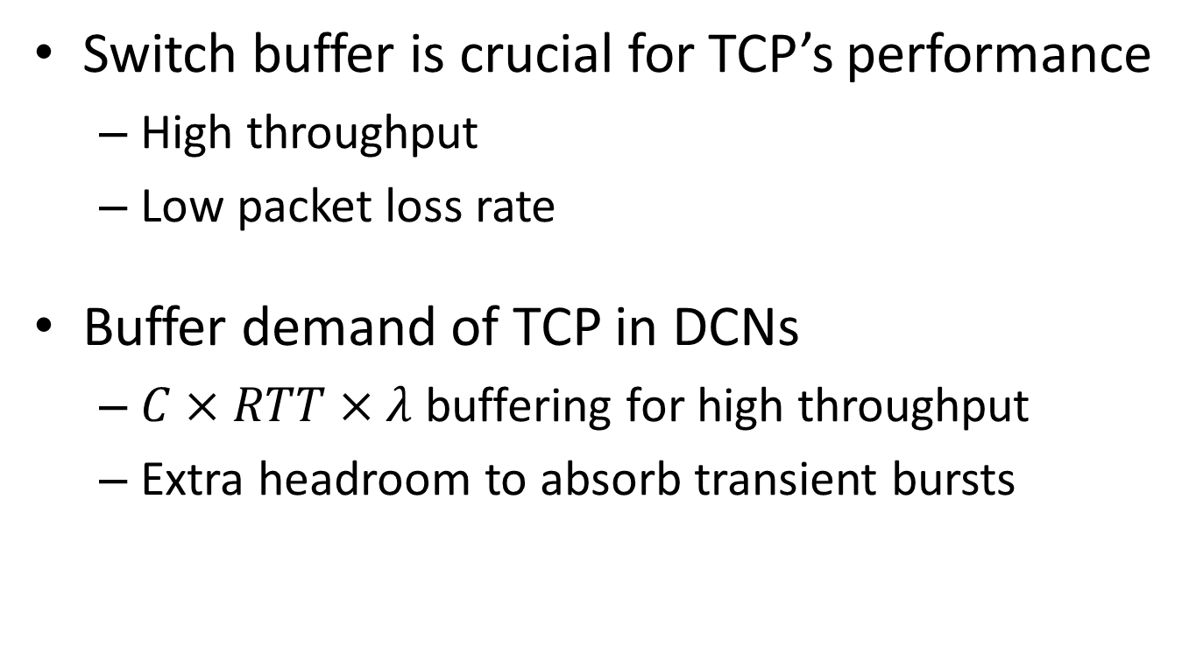
Switch Buffer
Switch buffer is crucial for TCP’s performance
High throughput
Low packet loss rate
Buffer demand of TCP in DCNs
$C×RTT×λ$ buffering for high throughput
Extra headroom to absorb transient bursts
In proportion to the link speed
Notes:
Now, let’s see the switch buffer demand of TCP

Slide 89
Recent Trends in DCNs
The link speed scales up
100Gbps and beyond
The switch buffer does not increase expectedly
Reasons: cost, price, etc.
1Gbps
10Gbps
40Gbps
100Gbps
80KB
192KB
384KB
512KB
Buffer / port of Broadcom chips
Notes:
说完链路带宽增加以后，要说TCP的buffer需求也是同比例增加的 TCP buffer demand also scales up

Slide 90
Observation
More and more shallow switch buffer
Buffer per port per Gbps keeps decreasing

Slide 91
Observation
Extremely Shallow-buffered DCNs
More and more shallow switch buffer
Buffer per port per Gbps keeps decreasing

Slide 92
Current Practice
Dynamic buffer allocation at switch
Excellent burst absorption
Egress Ports
1
2
3
4
Shared Buffer Pool
5
6
7
8
Notes:
Now, let’s see current buffer-related operation practice in industry. At the switch, operators typically enable dynamic buffer allocation. All switch ports are sharing a buffer pool. Compared to traditional static buffer, dynamic buffer allocation can achieve better burst tolerance.

Slide 93
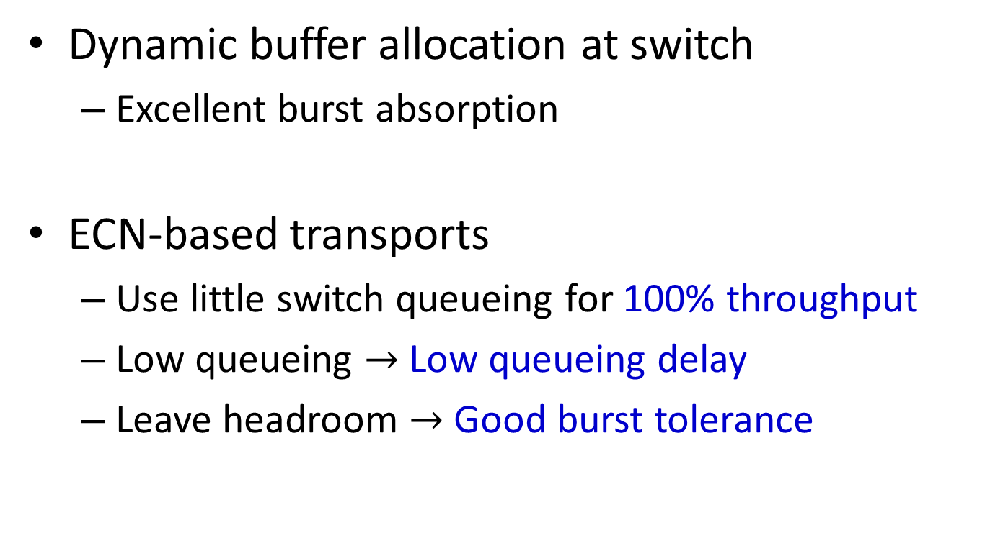
Current Practice
Dynamic buffer allocation at switch
Excellent burst absorption
ECN-based transports
Use little switch queueing for 100% throughput
Low queueing $→$ Low queueing delay
Leave headroom $→$ Good burst tolerance

Slide 94
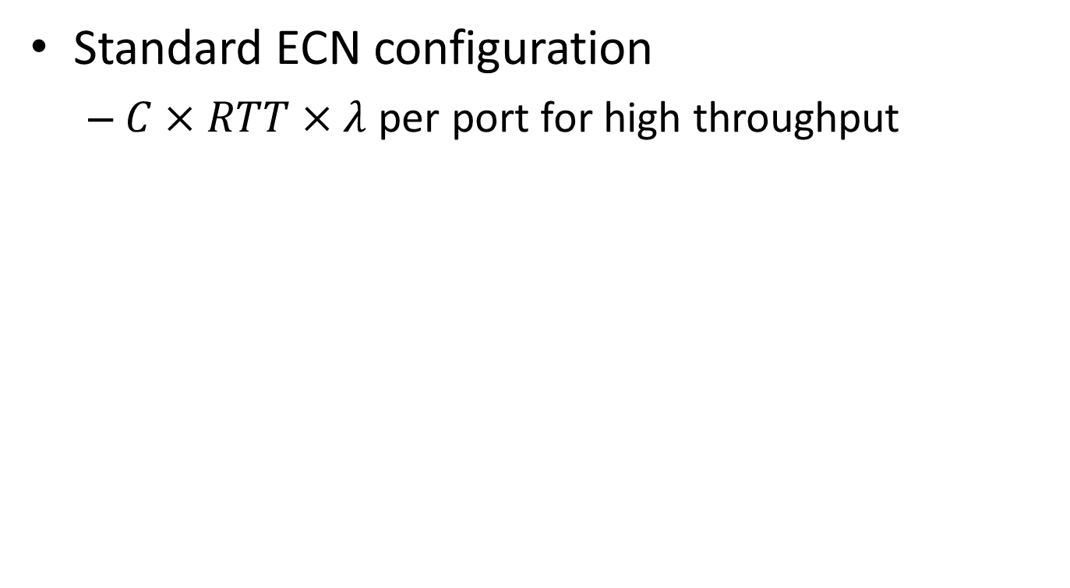
Problems of Existing Solutions (1)
Standard ECN configuration
$C×RTT×λ$ per port for high throughput
Buffer Occupancy
K
Time
Notes:
Now, let’s see problems of existing solutions in extremely shallow-buffered DCNs.
To achieve 100% throughput, operators typically make standard ECN configuration for each port. Each port requires C\times RTT\times \lambda buffering for high throughput.
要说明C\times RTT\times \lambda是一个很大的数值

Slide 95
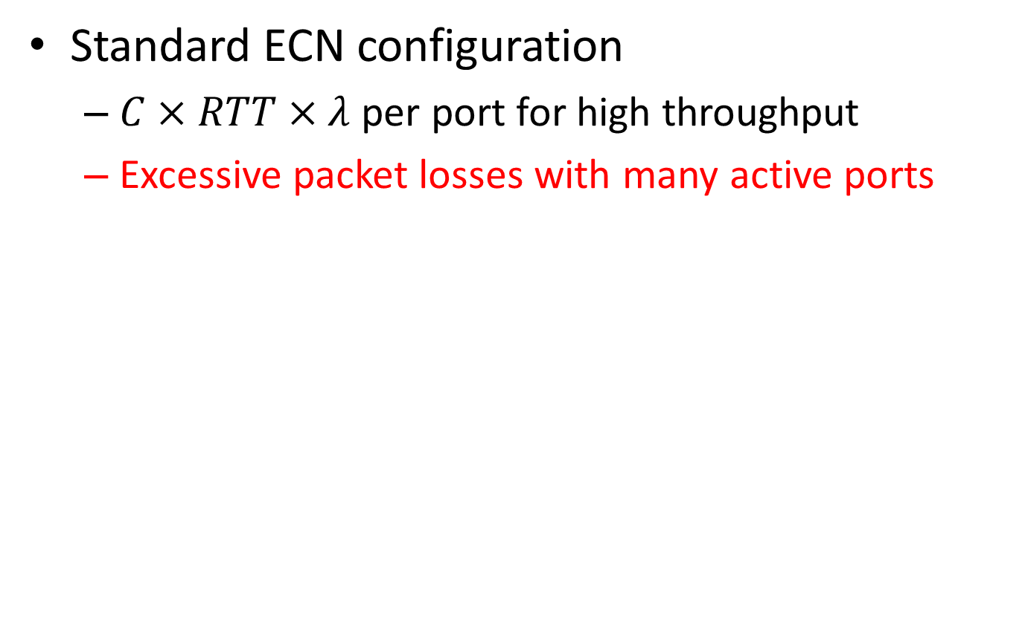
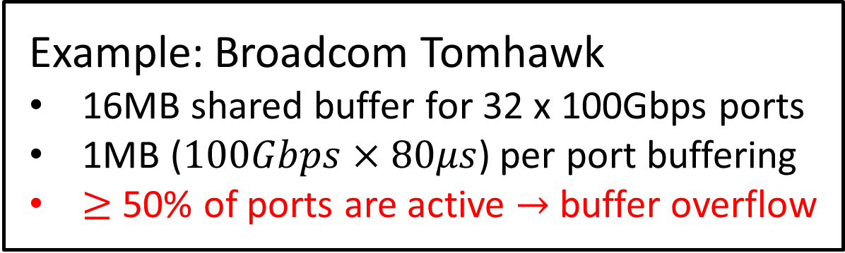
Problems of Existing Solutions (1)
Standard ECN configuration
$C×RTT×λ$ per port for high throughput
Excessive packet losses with many active ports
Example: Broadcom Tomhawk
16MB shared buffer for 32 x 100Gbps ports
1MB ($100Gbps×80μs$) per port buffering
$≥$ 50% of ports are active $→$ buffer overflow
Notes:
We take Broadcom Tomhawk chip as an example

Slide 96
Problems of Existing Solutions (2)
Conservative ECN configuration
Leave headroom for low packet loss rate
Buffer Occupancy
Avg. Buffer / Port
K
Time

Slide 97
Problems of Existing Solutions (2)
Conservative ECN configuration
Leave headroom for low packet loss rate
Significant throughput degradation with few active ports
Notes:
When few ports are active, the switch buffer resource is actually very abundant. However, ….

Slide 98
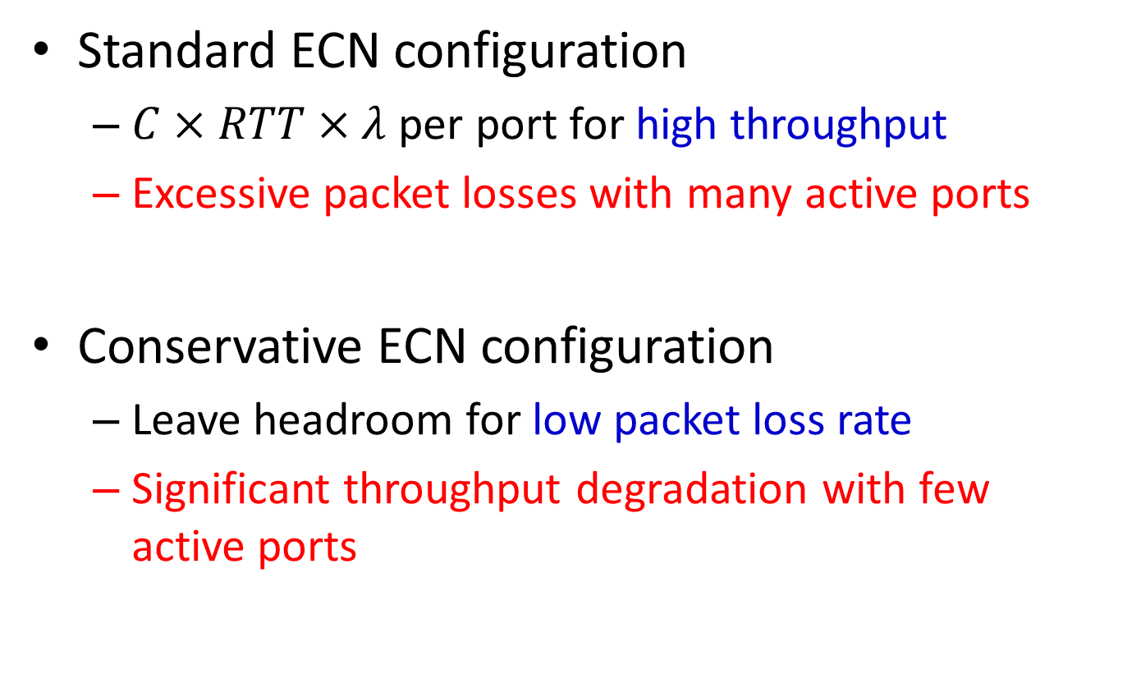
Summary of Problems
Standard ECN configuration
$C×RTT×λ$ per port for high throughput
Excessive packet losses with many active ports
Conservative ECN configuration
Leave headroom for low packet loss rate
Significant throughput degradation with few active ports

Slide 99
Design Goals
High Throughput
Low Packet Loss Rate
When many ports are active?
Packet loss rate prioritized over throughput
Readily-deployable
Legacy Network Stacks & Commodity Switch ASIC

Slide 100
Our Solution
High Throughput
Low Packet Loss Rate
When many ports are active?
Packet loss rate prioritized over throughput
Readily-deployable
Legacy Network Stacks & Commodity Switch ASIC
Buffer-aware Congestion Control

Slide 101
BCC Mechanisms
End-host
Legacy ECN-based transports
Switch
Per port standard ECN configuration
Shared buffer ECN/RED
OR
Notes:
要强调Shared buffer ECN/RED is a built-in function, 但是没人explore

Slide 102
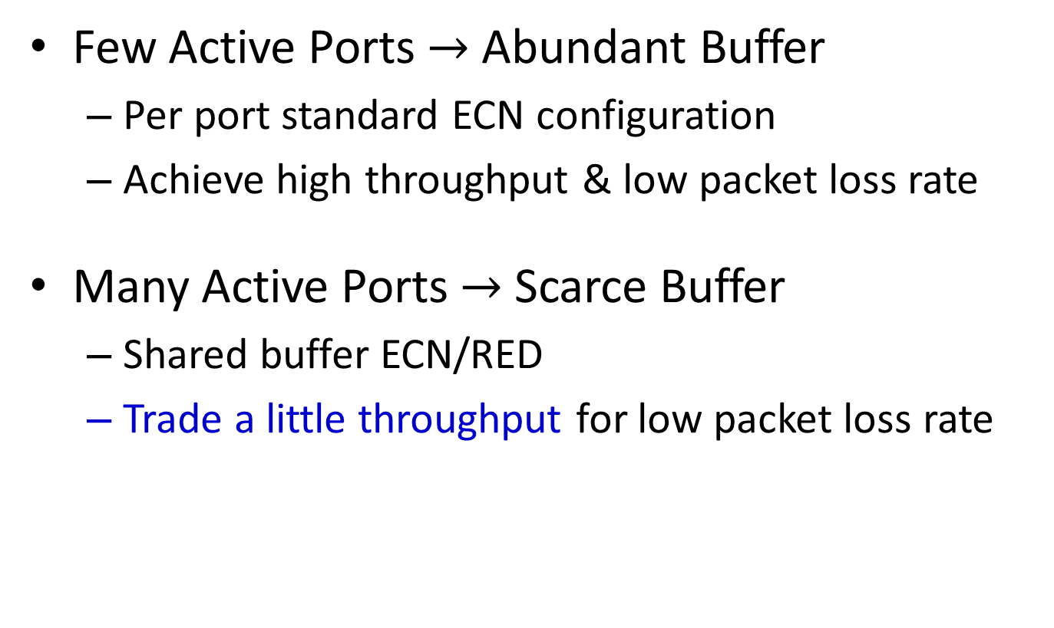
BCC in 1 Slide
Few Active Ports $→$ Abundant Buffer
Per port standard ECN configuration
Achieve high throughput & low packet loss rate
Many Active Ports $→$ Scarce Buffer
Shared buffer ECN/RED
Trade a little throughput for low packet loss rate
Buffer Aware

Slide 103
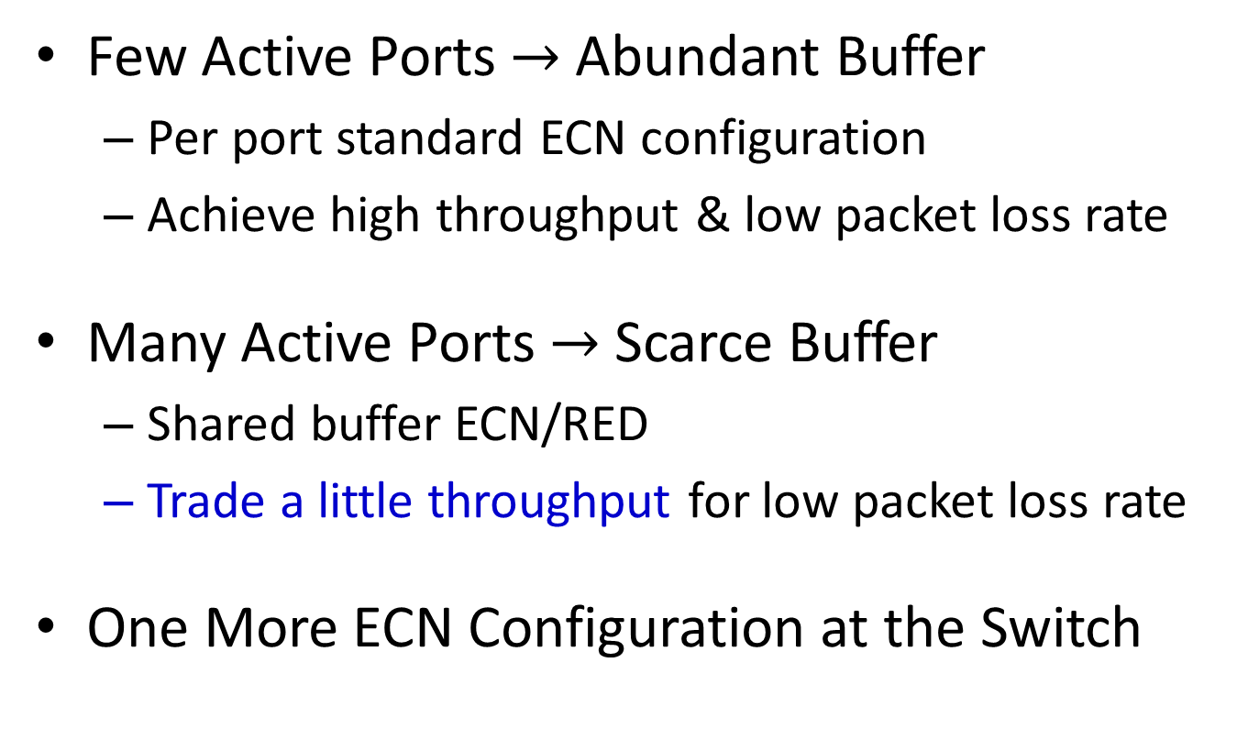
BCC in 1 Slide
Few Active Ports $→$ Abundant Buffer
Per port standard ECN configuration
Achieve high throughput & low packet loss rate
Many Active Ports $→$ Scarce Buffer
Shared buffer ECN/RED
Trade a little throughput for low packet loss rate
One More ECN Configuration at the Switch

Slide 104
Evaluation
Functionality Validation
Arista 7060CX-32S switch
Large-scale NS-2 Simulation
128-host 100Gbps spine-leaf fabric
Realistic production traffic
Schemes compares:
Standard per port ECN/RED (K = 720KB)
Conservative per port ECN/RED (K = 200KB)

Slide 105
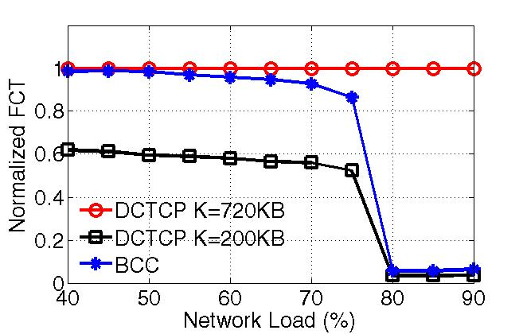
99th percentile FCT for Flows <100KB
TCP RTO
BCC keeps low packet loss rate

Slide 106
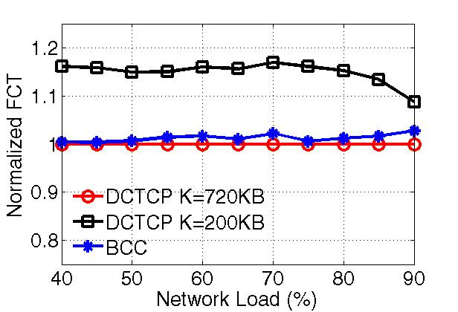
Average FCT for Flows > 10MB
BCC only trades a little throughput

Slide 107
BCC Recap
Abundant Buffer
Deliver high throughput & low packet loss rate
Scarce Buffer
Trade a little throughput for low packet loss rate
Readily-deployable
One more ECN configuration is enough

Slide 108
Summary
Notes:
After introducing research background, let’s move to my thesis work.

Slide 109
Thesis Contributions
PIAS: a practical information-agnostic flow scheduling to minimize flow completion time
MQ-ECN & TCN: new AQM solutions to enable ECN marking over packet schedulers
BCC: a simple buffer-aware solution for high speed extremely shallow-buffered DCNs

Slide 110
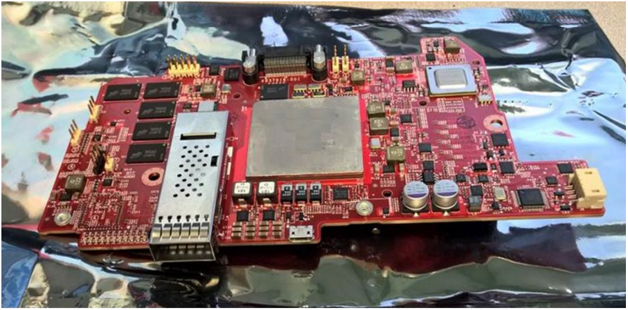
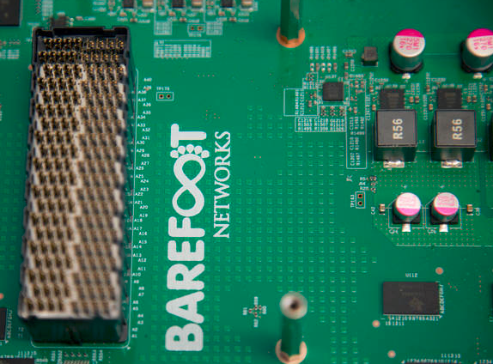
Future Work: High Speed Programmable DCNs
Many open problems in high speed DCNs
More and more network stacks & functions offloaded to programmable hardware
SmartNIC @ Microsoft Azure
Tofino @ Barefoot Networks

Slide 111
Publication list in PhD study
Wei Bai, Li Chen, Kai Chen, Dongsu Han, Chen Tian, Hao Wang, “Information-Agnostic Flow Scheduling for Commodity Data Centers”, USENIX NSDI 2015 (journal version accepted by IEEE/ACM Transactions on Networking in 2017)
Wei Bai, Li Chen, Kai Chen, Haitao Wu, “Enabling ECN in Multi-Service Multi-Queue Data Centers”, USENIX NSDI 2016
Wei Bai, Kai Chen, Li Chen, Changhoon Kim, Haitao Wu, “Enabling ECN over Generic Packet Scheduling”, ACM CoNEXT 2016
Wei Bai, Li Chen, Kai Chen, Dongsu Han, Chen Tian, Weicheng Sun, “PIAS: Practical Information-Agnostic Flow Scheduling for Data Center Networks”, ACM HotNets 2014
Wei Bai, Kai Chen, Haitao Wu, Wuwei Lan, Yangming Zhao, “PAC: Taming TCP Incast Congestion Using Proactive ACK Control”, IEEE ICNP 2014
Hong Zhang, Junxue Zhang, Wei Bai, Kai Chen, Mosharaf Chowdhury, “Resilient Datacenter Load Balancing in the Wild”, (to appear) ACM SIGCOMM 2017.
Ziyang Li, Wei Bai, Kai Chen, Dongsu Han, Yiming Zhang, Dongsheng Li, Hongfang Yu, “Rate-Aware Flow Scheduling for Commodity Data Center Networks”, IEEE INFOCOM 2017
Li Chen, Kai Chen, Wei Bai, Mohammad Alizadeh, “Scheduling Mix-flows in Commodity Datacenters with Karuna”, ACM SIGCOMM 2016
Shuihai Hu, Wei Bai, Kai Chen, Chen Tian, Ying Zhang, Haitao Wu, “Providing Bandwidth Guarantees, Work Conservation and Low Latency Simultaneously in the Cloud”, IEEE INFOCOM 2016
Hong Zhang, Kai Chen, Wei Bai, Dongsu Han, Chen Tian, Hao Wang, Haibing Guan, Ming Zhang, “Guaranteeing Deadlines for Inter-Datacenter Transfers”, ACM EuroSys 2015 (journal version in IEEE/ACM Transactions on Networking, 2017)
Shuihai Hu, Kai Chen, Haitao Wu, Wei Bai, Chang Lan, Hao Wang, Hongze Zhao, Chuanxiong Guo, “Explicit Path Control in Commodity Data Centers: Design and Applications”, USENIX NSDI 2015 (journal version in IEEE/ACM Transactions on Networking, 2016)
Yangming Zhao, Kai Chen, Wei Bai, Minlan Yu, Chen Tian, Yanhui Geng, Yiming Zhang, Dan Li, Sheng Wang, “RAPIER: Integrating Routing and Scheduling for Coflow-aware Data Center Networks”, IEEE INFOCOM 2015
Yang Peng, Kai Chen, Guohui Wang, Wei Bai, Zhiqiang Ma, Lin Gu, “HadoopWatch: A First Step Towards Comprehensive Traffic Forecasting in Cloud Computing”, IEEE INFOCOM 2014 (journal version in IEEE/ACM Transactions on Networking, 2016)

Slide 112
Thanks!

Slide 113
Backup Slides

Slide 114
Does PIAS lead to Starvation?
Root cause of priority queueing
Flows in low priority queues get stuck if high priority traffic fully utilizes the link capacity
Undesirable result
Connections get terminated unexpectedly
Priority 1
Priority 2
……
Priority K

Slide 115
Inspecting Starvation in Practice
Testbed Benchmark traffic (from Web search trace)
5000 flows (~5.7 million MTU-sized packets) , 80% utilization
10ms TCP RTOmin
Measurement results
200 TCP timeouts, 31 two consecutive TCP timeouts
No connection gets terminated unexpectedly
Why no starvation?
DCN traffic is heavy-tailed
Per-port ECN/RED pushes back high priority traffic
What if starvation really occurs?
Aging or Weighted Fair Queueing (WFQ)

Slide 116
NS-2: Overall Performance
Web Search
Data Mining
PIAS has an obvious advantage over DCTCP in both workloads.
Notes:
Now, let’s see the overall average flow completion times in ns-2. We find that PIAS outperforms. DCTCP is a fair sharing scheme. Compare to DCTCP, PIAS enforces multi-level feedback queue scheduling by levering priority queues at switches. It’s more efficient.

Slide 117
NS-2: Small Flows (<100KB)
Web Search
Data Mining
Around 50% improvement
Simulations confirm testbed experiment results
Notes:
The figure shows the completion times of small flows. We find that, compared to DCTCP, PIAS can achieve 50% lower FCT. So this confirms our testbed experiment results.

Slide 118
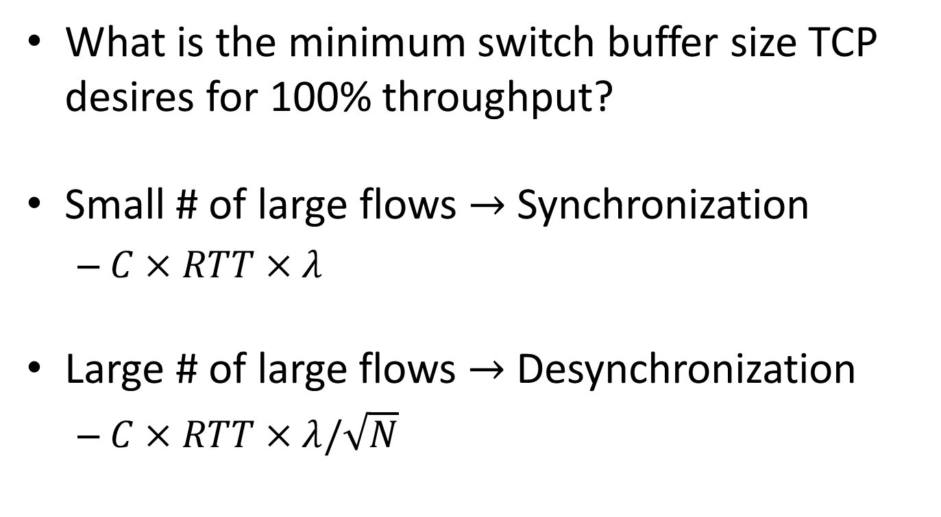
Sizing Router Buffers
What is the minimum switch buffer size TCP desires for 100% throughput?
Small # of large flows $→$ Synchronization
$C×RTT×λ$
Large # of large flows $→$ Desynchronization
$C×RTT×λ/\sqrt{N}$

Slide 119
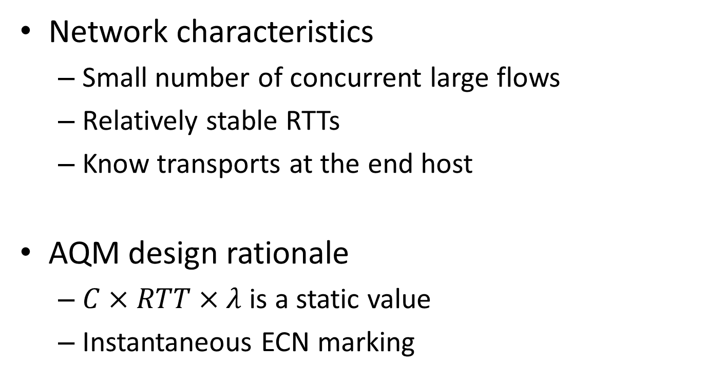
AQM in DCNs
Network characteristics
Small number of concurrent large flows
Relatively stable RTTs
Know transports at the end host
AQM design rationale
$C×RTT×λ$ is a static value
Instantaneous ECN marking

Slide 120
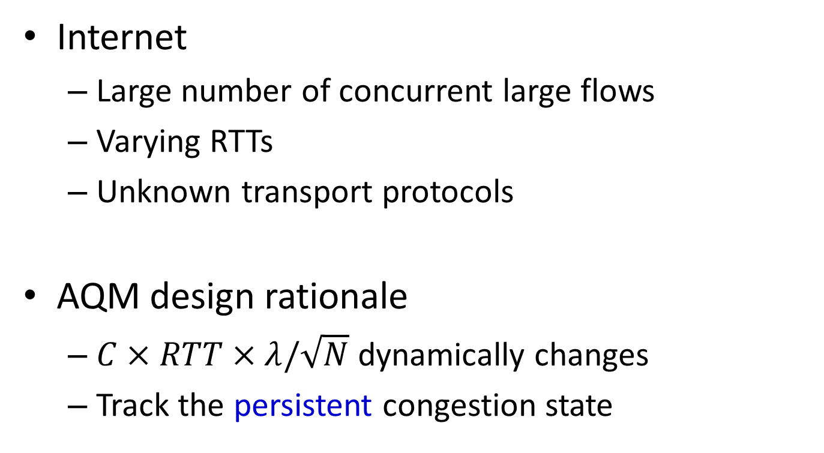
AQM in Internet
Internet
Large number of concurrent large flows
Varying RTTs
Unknown transport protocols
AQM design rationale
$C×RTT×λ/\sqrt{N}$ dynamically changes
Track the persistent congestion state

Slide 121
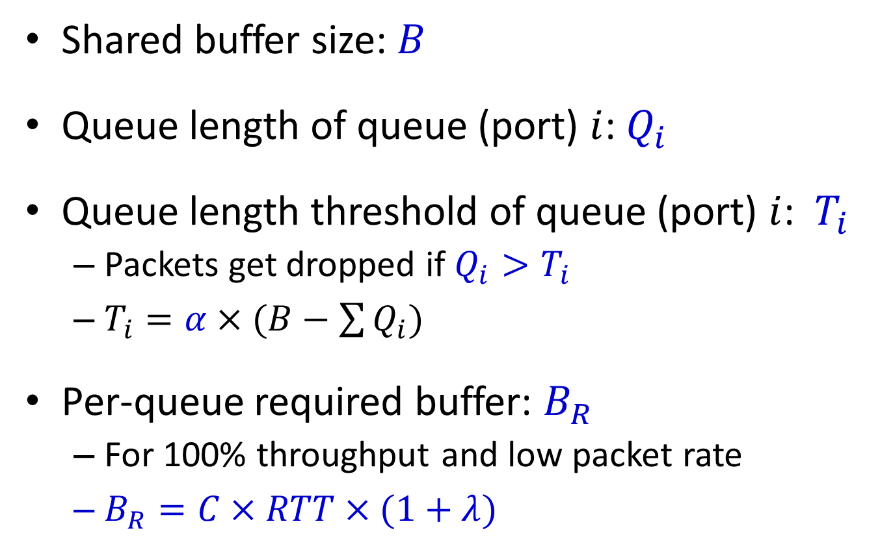
BCC Model
Shared buffer size: $B$
Queue length of queue (port) $i$: $Q_{i}$
Queue length threshold of queue (port) $i$: $T_{i}$
Packets get dropped if $Q_{i}>T_{i}$
$T_{i}=α×(B−\sum{Q_{i}})$
Per-queue required buffer: $B_{R}$
For 100% throughput and low packet rate
$B_{R}=C×RTT×(1+λ)$

Slide 122

BCC Model
Property of $T_{i}$
# of active queues: $M$
$T_{i}={B×α}/{(1+M×α)}$
Larger $M$ $→$ Smaller $T_{i}$
When $T_{i}<B_{R}$, no enough buffer
$T_{i}=α_{i}×\left(B−\sum{Q_{i}}\right)<B_{R}$
BCC throttles the shared buffer occupancy

